Slide 1
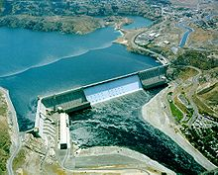
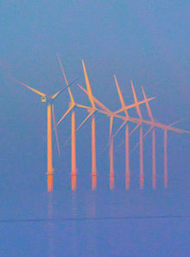
Integration of Renewable Energy Sources

Slide 2
Contents
Renewable Energy/Sources
Smart Grid/Smart Grid Domains
Global Energy Stats
Objectives and advantages
Perspective model of the system
Comparison of capacity factors
Introduction and advantages of HVDC over AC transmission
DC-DC conversion at generating end
Devices and equipment used
Communication and Security
Interoperability of smart grid

Slide 3
Renewable Energy Sources
From the sources those replenishes continuously.
Pollution free.
Easy access of sources.
Environment friendly methods to generate electrical energy from these sources.
Environment friendly disposal after use.
No harmful bi-product.
No green house gases.

Slide 4
Smart Grid and Smart Grid Domains
GRID: Interconnection of n number of generating stations and substations.
Introducing the digital controlling and operating techniques.
Duplex mode of Communication among various utilities of a power system.
Automation and quick sensing of faults across transmission lines.

Slide 5
Smart Grid and Smart Grid Domains
Identify possible communication path in smart grid.
Consists of seven domains.
Customers
Markets
Service providers
Operations
Bulk generation
Transmission
Distribution

Slide 6
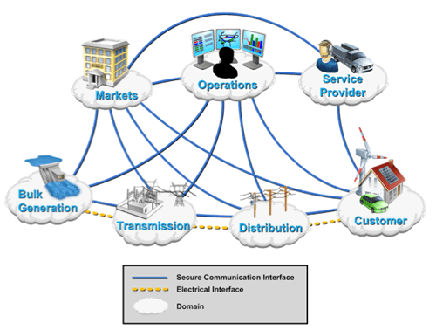
Smart Grid Domain (Conceptual model)

Slide 7
Objective
Efficient use of renewable energy along with conventional energy.
Increasing energy efficiency.
Making power grid less prone to dynamic faults (decentralisation of energy sources)
Increasing power stability and reducing carbon footprint.
Making operation of power flow more resilient
Enhancing bulk power generation.

Slide 8
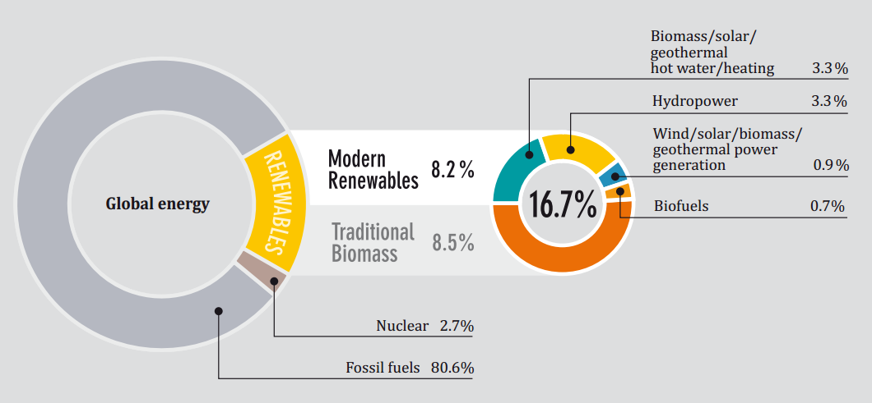
Global Energy Stats

Slide 9
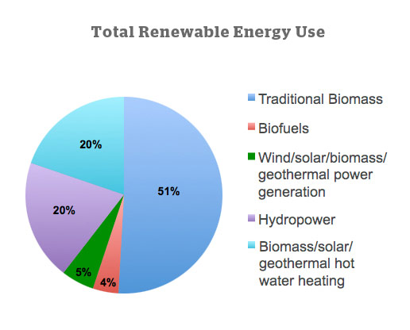
Global Energy Stats

Slide 10
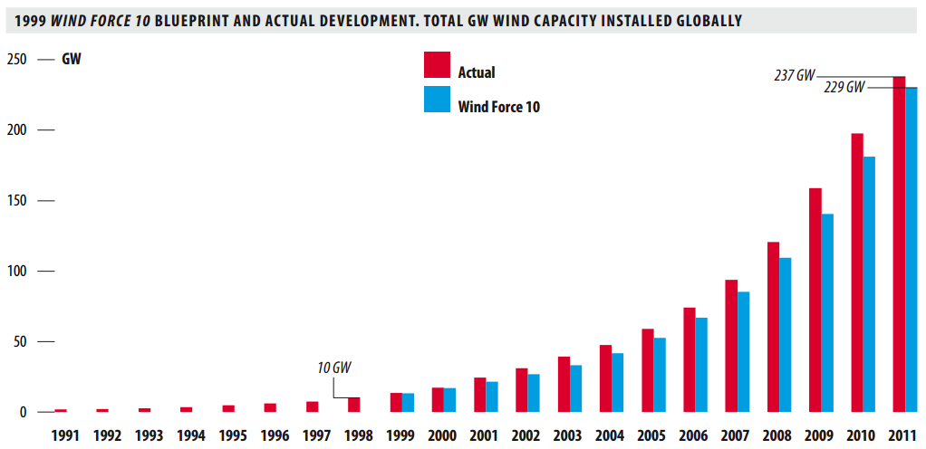
Global Energy Stats

Slide 11
Comparison of Capacity Factors
According to US Energy Information Administration:
Natural Gas Plant–11.4%
Oil–7.8%
Hydroelectric–39.8%
Other renewables (Wind/Solar/Biomass)–33.9%
Coal–63.8%
Nuclear–90.3%

Slide 12
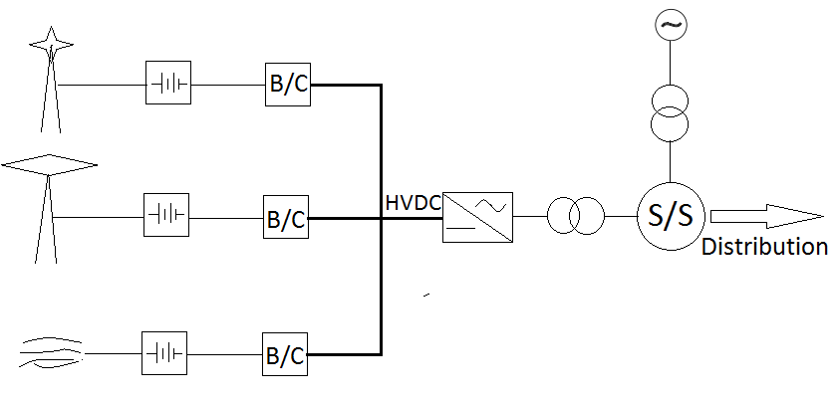
Perspective model of the system

Slide 13
HVDC Configuration
Electrical power transmission using direct current.
Act as a link between two unsynchronised AC power
systems.
Possible configuration:
Monopole
Monopole and earth return
Monopole and metallic return
Symmetrical monopole
Bipolar
Back to back
Multi-terminal System
Tri-pole

Slide 14
Advantages of HVDC
No requirement of reactive power compensation.
Lesser ohmic losses.
Lesser conductor is required for transmission
There by lesser amount to supporting structures and insulating discs.
Transmission line become electrically more stable.
Chances of grid failure decreases as there is no fluctuation in frequency.

Slide 15
DC-DC Conversion at Generating End
Wind generators, solar panels and other renewable sources mainly give DC voltage at low level and needed to be step up up to the level of HVDC.
Not possible by using transformers.
Counter solution for DC-DC conversion is Boost Converters.
Relatively costly because uses very high speed power electronics switches.

Slide 16
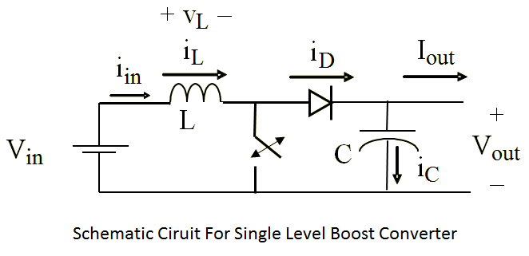
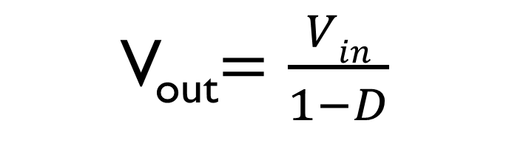
DC-DC Conversion at Generating End
Voltage is the function of operating time of MOSFET here
V_{out}$=\frac{Vin}{1−D}$

Slide 17
Devices and Equipment
Boost Converter
FACT Controller(Flexible AC Transmission Controller)
STATCOM
SSSC
UPFC(Unified power flow controller)
IEEE300 bus system
Phase shift Transformer

Slide 18
Communication and Security
Must be capable for 200MB/s data transfer speed
Duplex communication mode
Power Line Carrier Communication(PLCC)
Wi-Fi (IEEE Standards 802.11)
Wi-Max(IEEE Standards 802.16)
WWAN(IEEE Standards 802.15)
Remedial Action Scheme(RAS)

Slide 19
Metering and Supervision
In Case of HVDC it is not possible to use CT’s and PT’s directly.
Three phase full converters are required before CT’s and PT’s.
Master Relay, Supervision Relay and Trip Relay are to be used accordingly.
Energy Management System(EMS) and Distributed Control System(DCS) is to be used in Grid Management.
Mobile Fleet Voice and Data Dispatcher assists EMS and DCS.

Slide 20
Interoperability of Smart Grid
Interfacing with Advanced Metering System(AMI)
Interfacing with transportation
Future Extension for interfacing with transportation.

